Slide 1
Functional programming in R
And introduction based on SAS Macros

Slide 2

Learning R Functions from SAS Macros
Introductions
Similarities
Global macro variables
User defined macros
Conditional programming
Differences
Side effects
Returning multiple objects
Tips and tricks

Slide 3

SAS to R Experience
American Cancer Society, 2010-2021, Scientist
60+ publications, including Nature, NEJM, BMJ, JAMA, Surgeon Generals Reports
Lead migration from SAS to R
Maintained 9 R packages
Babylon Health, 2021-2022, Epidemiologist
AI Triage team
Shiny Developer
ProCogia, 2022-present, Delivery Manager
Enterprise SAS to R migration
Delivery manager for international consulting team
Clients include life-sciences, finance, local government
LinkedIn
E-Mail

Slide 4
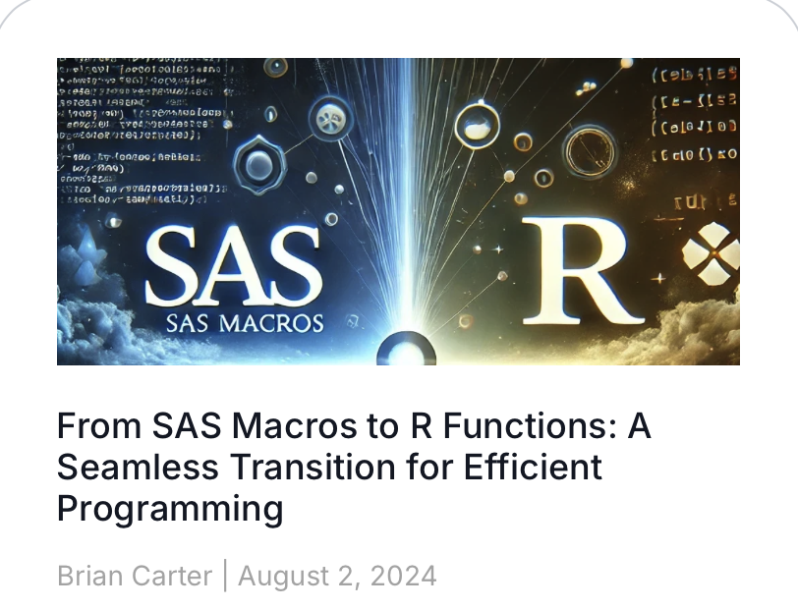

Materials for this Webinar
Link to Blog
Link to blog
Altair SLC Blog
Github repo

Slide 5
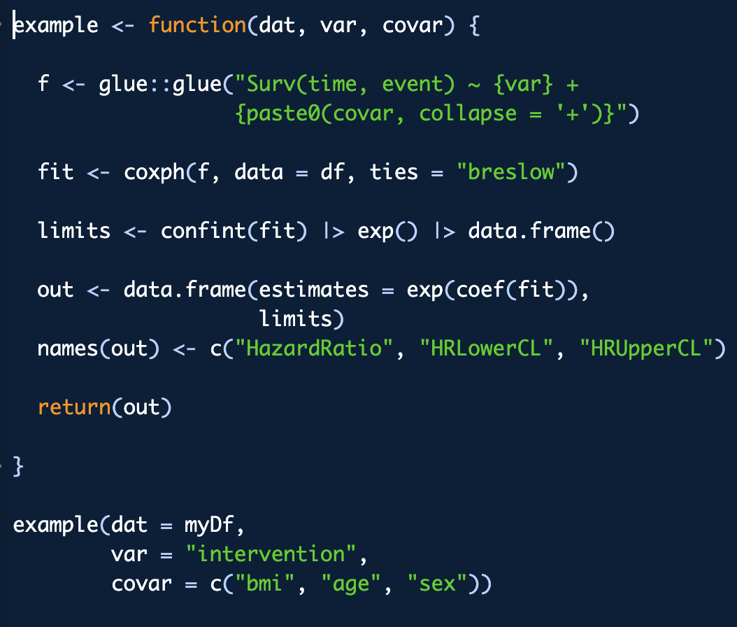
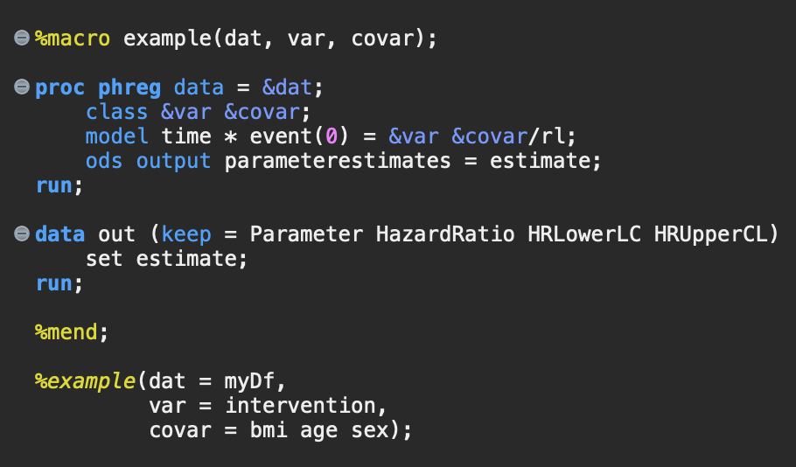
How do I teach R to SAS users?

Slide 6
Macros and Functions serve the same purpose. They build efficiencies by reducing programming time, simplifying debugging, and reducing errors.

Slide 7
SAS Macros
Macros are programs that write other programs by incorporating a set of dynamic parameters.
R Functions
Functions in R are self-contained environments that will execute a process without side effects.

Slide 8
SAS Macros
The SAS Macro system includes macro objects identified with the % prefix, and macro variables identified with the & prefix.
R Functions
Functions are just one of many kinds of objects in R, but they can be recognized as fun() with a set of arguments.

Slide 9
SAS macros can be global in scope, applying to an entire program, or localized within a user-defined workflow.

Slide 10
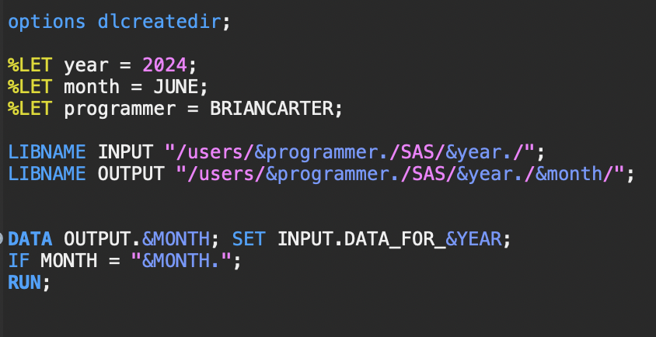
Global macros
Global macros are often used to parameterize automated programs, setting dates, file paths, and data set names.

Slide 11
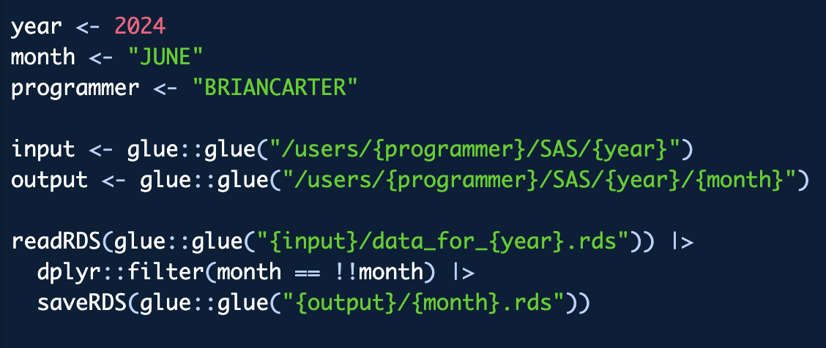
This can be replicated in R using glue()
You can set up your programs the same in R. You can use glue() to execute objects within a curly brackets to parameterize your programs.

Slide 12
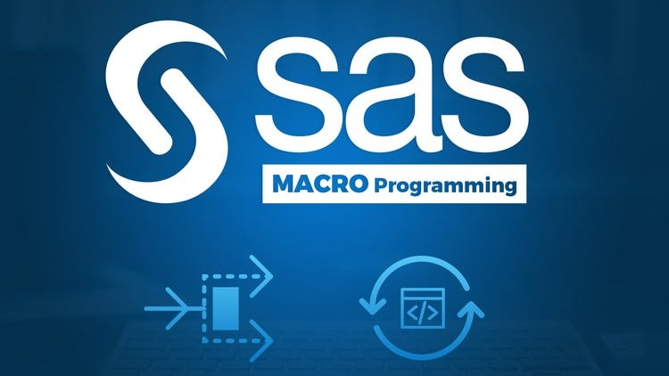
User defined macros
The most powerful application of macros in SAS is the ability to develop custom repeatable workflows.
Data manipulation
Statistical pipelines
Tables/Figures
Custom reports

Slide 13
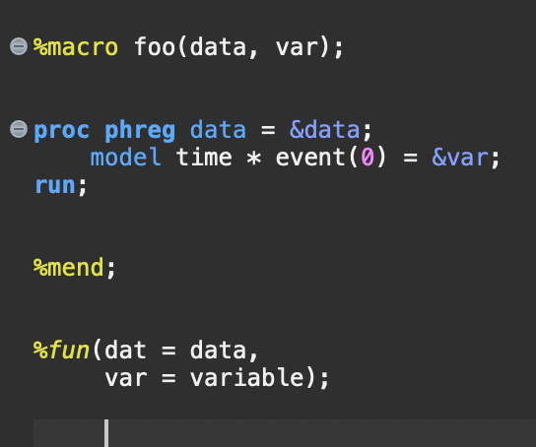

All user-defined macros follow the same structure
Macros must be named and can include arguments that will parameterize the workflow
Macros have a body that detail all the steps SAS takes to complete the process.
The user can call the macro later in the program.

Slide 14
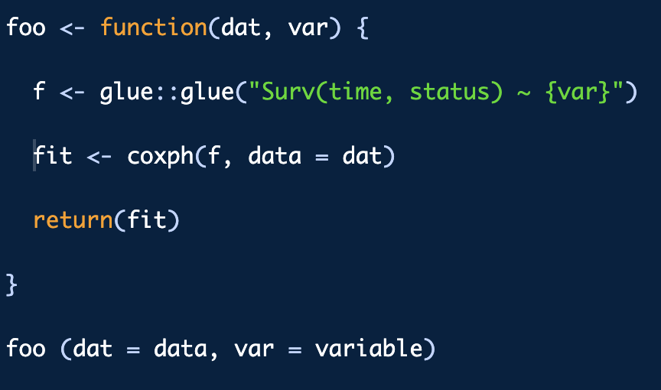
SAS users will already be familiar with the structure of an R function
R functions are also named and can have required or optional arguments.
The function body includes all steps of the process
An R function must have explicit or implicit return values.
A user can call the function when ready.

Slide 15
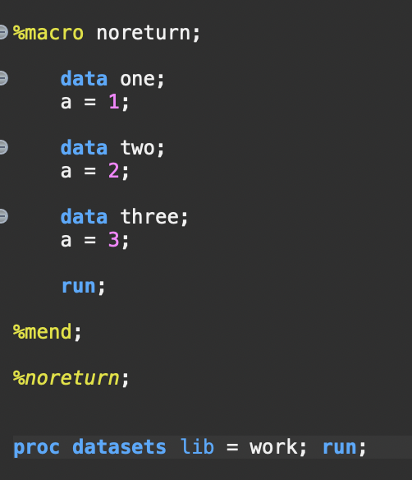
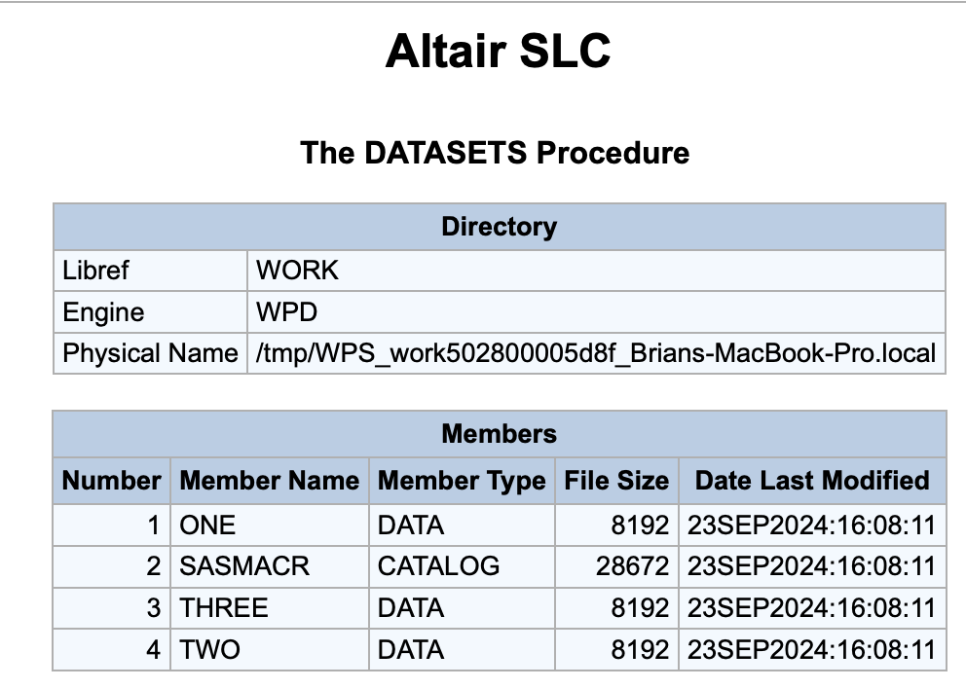
What’s up with the return()?
One of the biggest differences users will notice between SAS and R is that all intermediate steps in an R function are lost after execution unless explicitly returned.

Slide 16
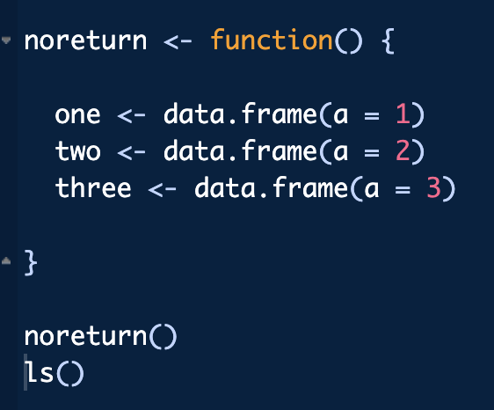
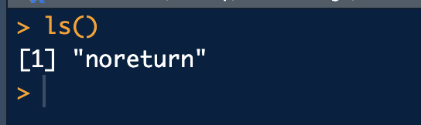
What’s up with the return()?
Functions in R are self-contained environments that will execute a process without side effects.
A side effect is an observable change in the operating environment other than an explicitly requested return value.

Slide 17
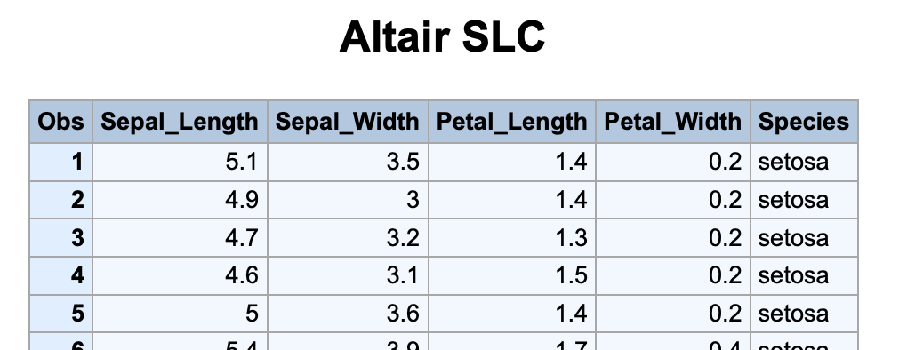
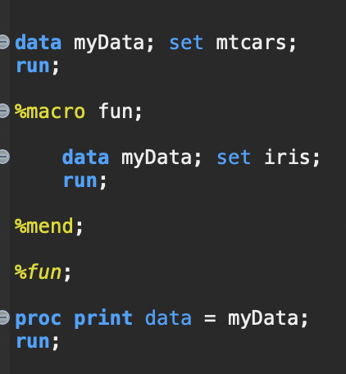
What will we get when we print myData?

Slide 18
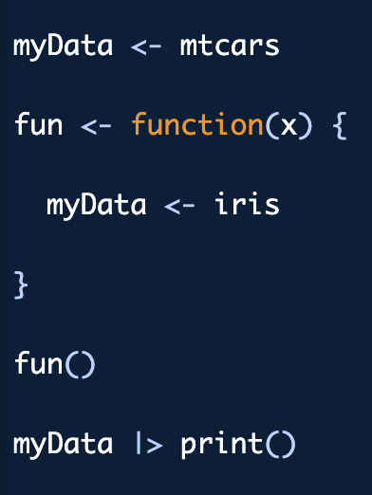
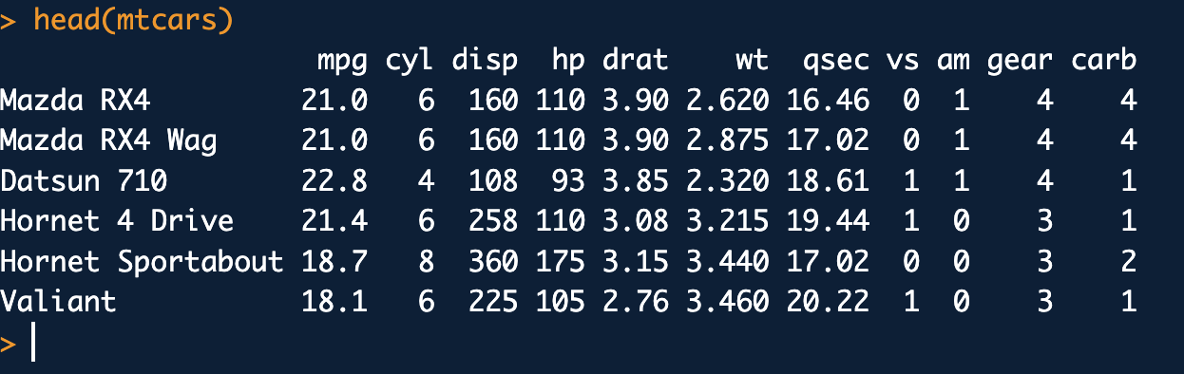
What will we get when we print myData?

Slide 19
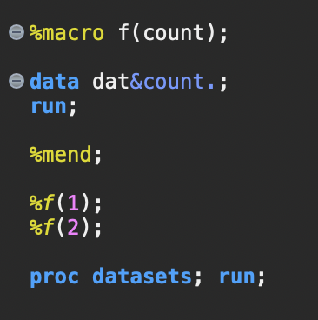
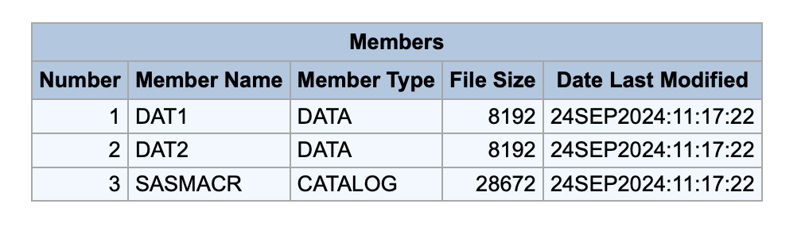
SAS Macros require extra effort to protect against unintended side effects

Slide 20
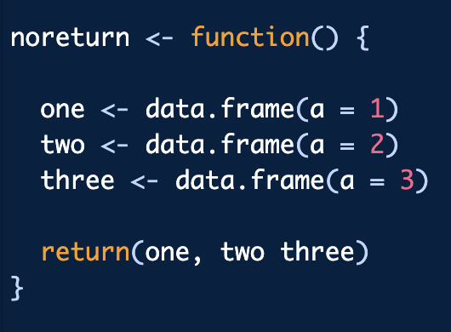
Wait, so R functions can only return a single object?
An R function will only return a single object

Slide 21
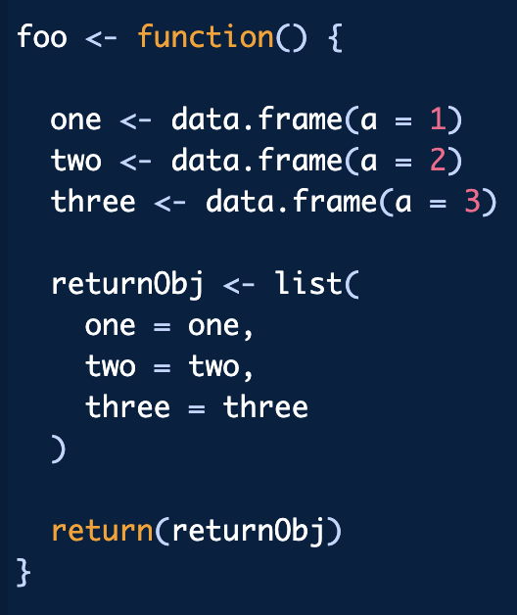
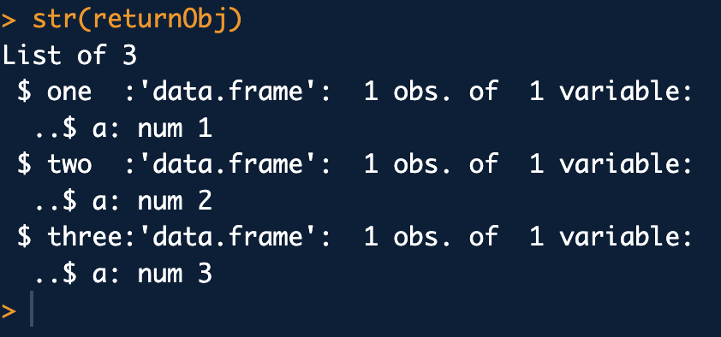
Wait, so R functions can only return a single object?
But you can return a list with as many objects as you want in it.

Slide 22

Why do we care about this?
I see a lot of SAS programmers struggle with this
Forces the programmer to think about the environment
Creates safer workflows

Slide 23
Condition program execution
Condition
Do this
Do something else
Your macros can make decisions for you

Slide 24
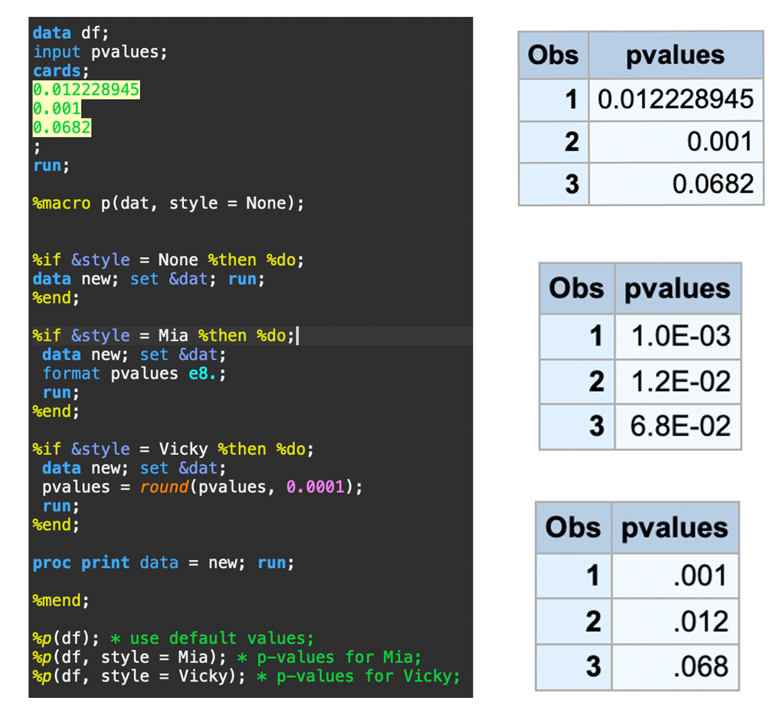
Complicated workflows: conditional execution
I wanted to format my p-values differently depending on the preferences of the PI I was working with.
Conditional macro programming uses %if - %then - %else

Slide 25
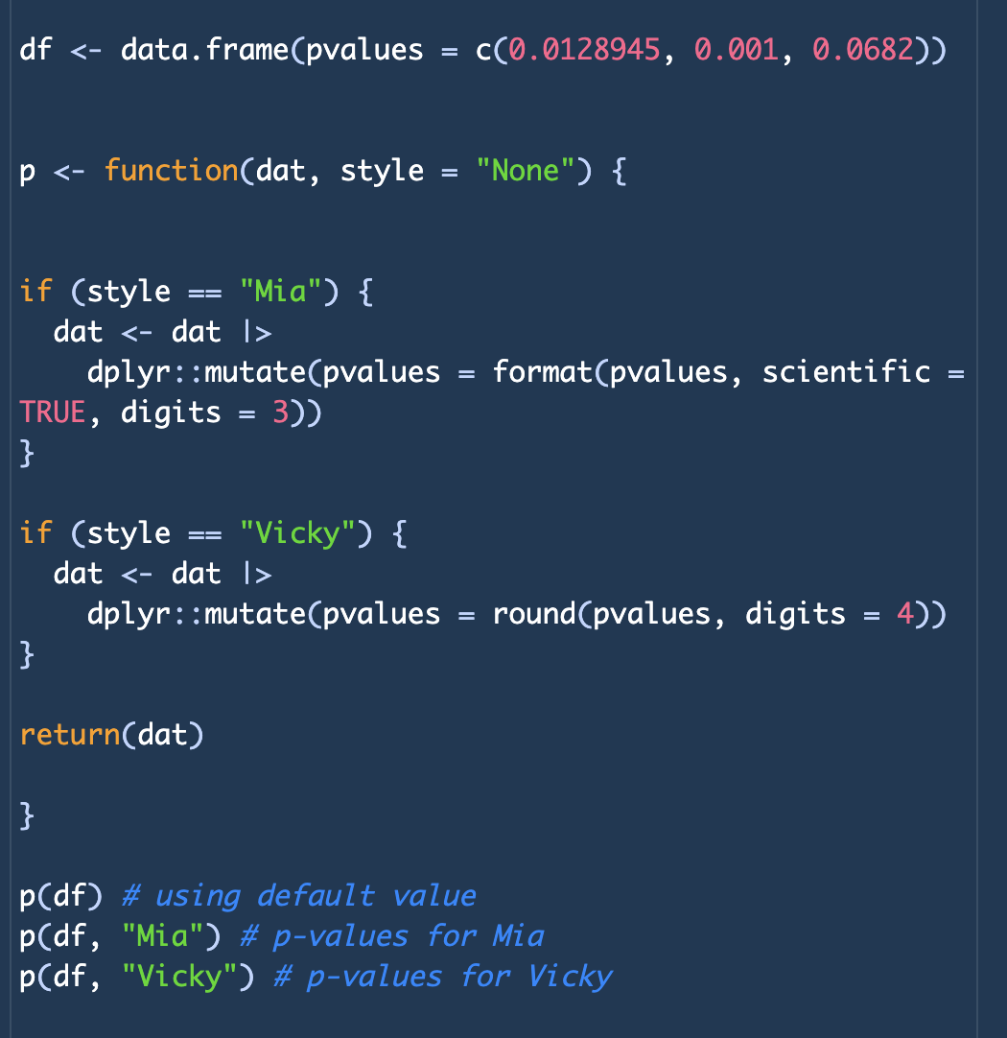
Complicated workflows: conditional execution
We can do the same thing in R using the if and else

Slide 26
Let’s talk about some tips and suggestions for writing better R functions using some tools that are unavailable to SAS.

Slide 27
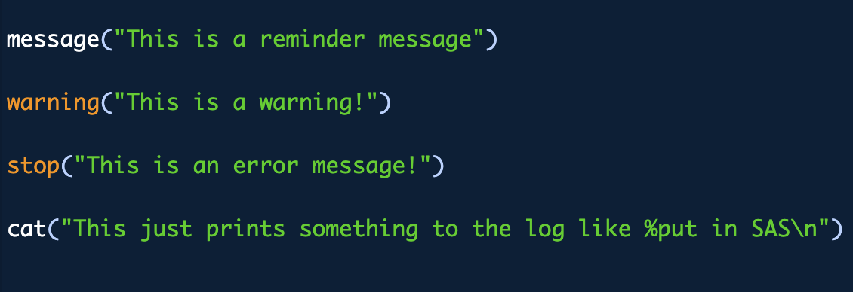
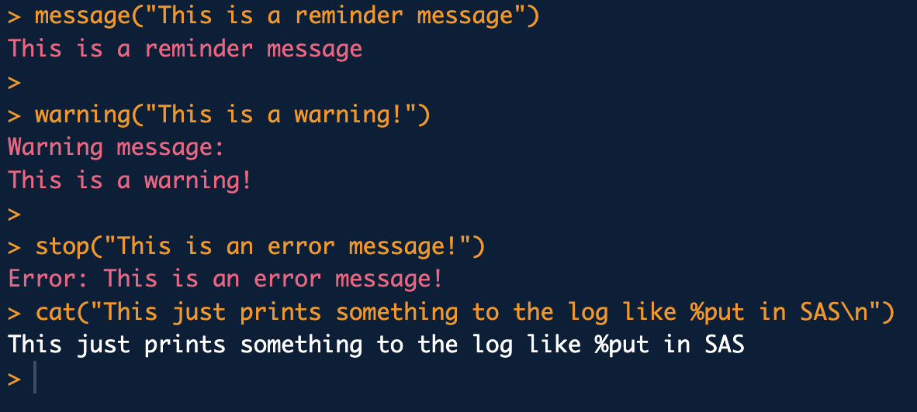
Communicating with your users (or yourself)
I like to add helpful messages to my functions to alert my future-self to run time errors or potential issues.

Slide 28
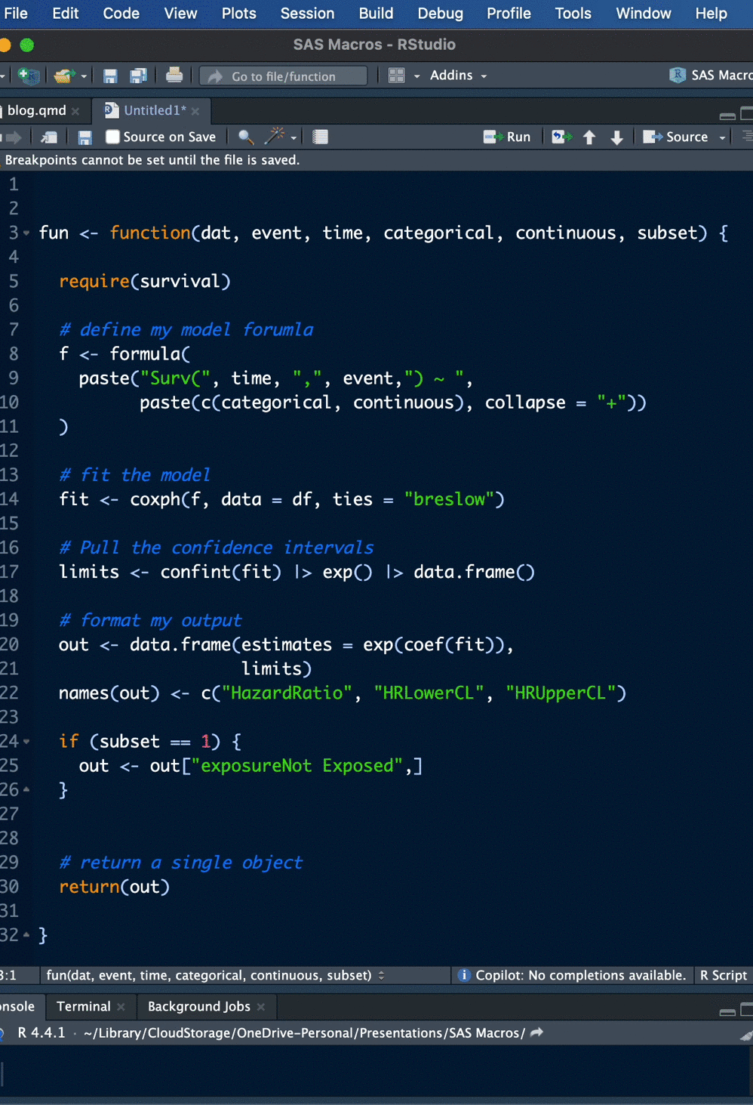

Documentation

Slide 29
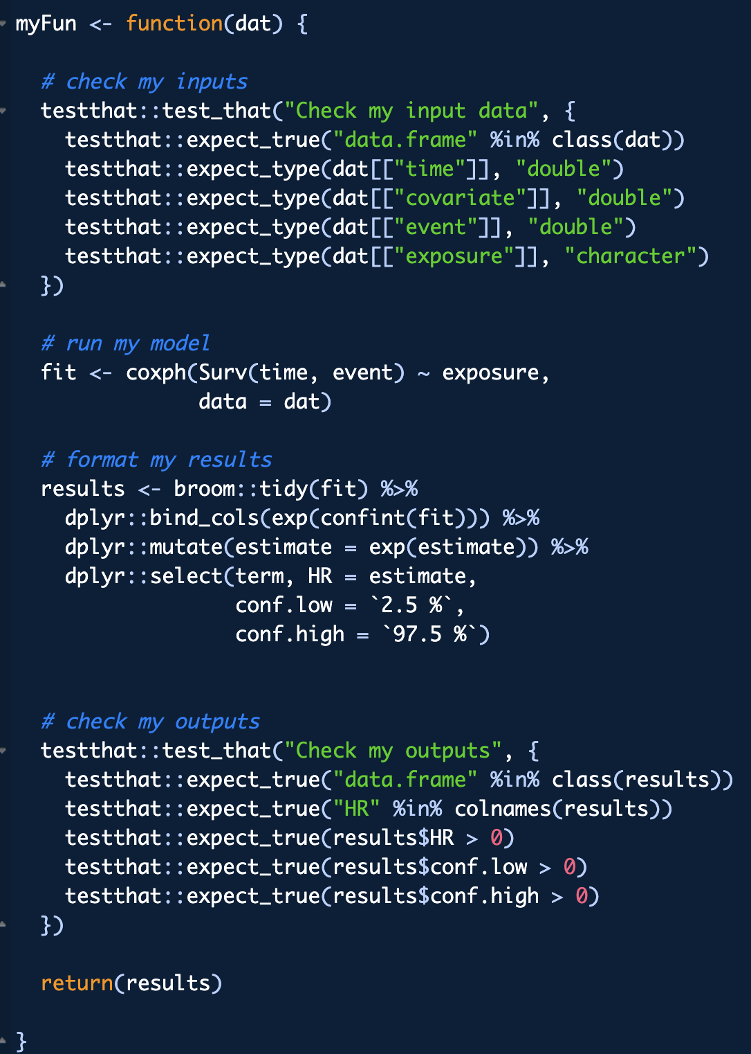

Testing your functions

Slide 30
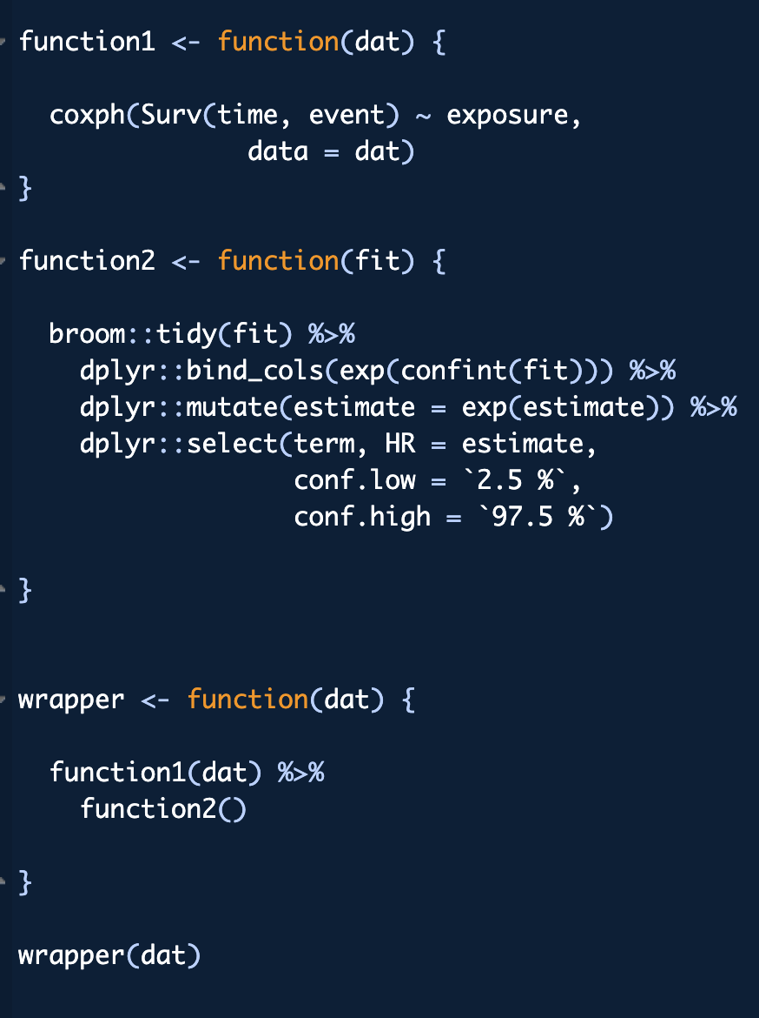
Keep it simple
For whatever reasons, SAS programmers often create monster macros. Monster macros are rarely portable and are difficult to debug or test.
Your functions should do one thing perfectly.

Slide 31
Final Tip
The best way to learn how to learn functional programming is to start writing some functions. If you already feel confident as a macro programmer, you’ve already mastered the automation mindset. Just jump in!

Slide 32
Thank you

